Slide 1


My Work
Work Experience
Education
About Me
Cover
PORTOFOLIO

Slide 2
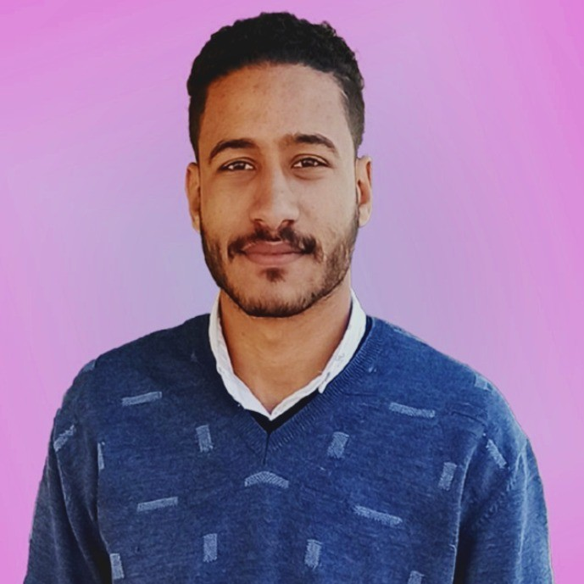
My Work
Work Experience
Education
About Me
Cover
ABOUT ME
Hello, my name is Mohamed Radwan. I’m a web designer with foundational training in HTML, CSS, and JavaScript, and experience in UX design. My journey began in college, and I’ve since led team projects and completed advanced training to develop strong web design skills.

Slide 3



My Work
Work Experience
Education
About Me
Cover
EDUCATION
Courses: HTML, CSS
Final Project: Developed a project in web design
National Telecommunications Institute (NTI)
Studied: HTML, CSS, JavaScript, Bootstrap, Media QueriesFinal Project: Team leader for a collaborative web design project.Edraak - UX Design Training
Focus: User experience principles and practical UX application

Slide 4
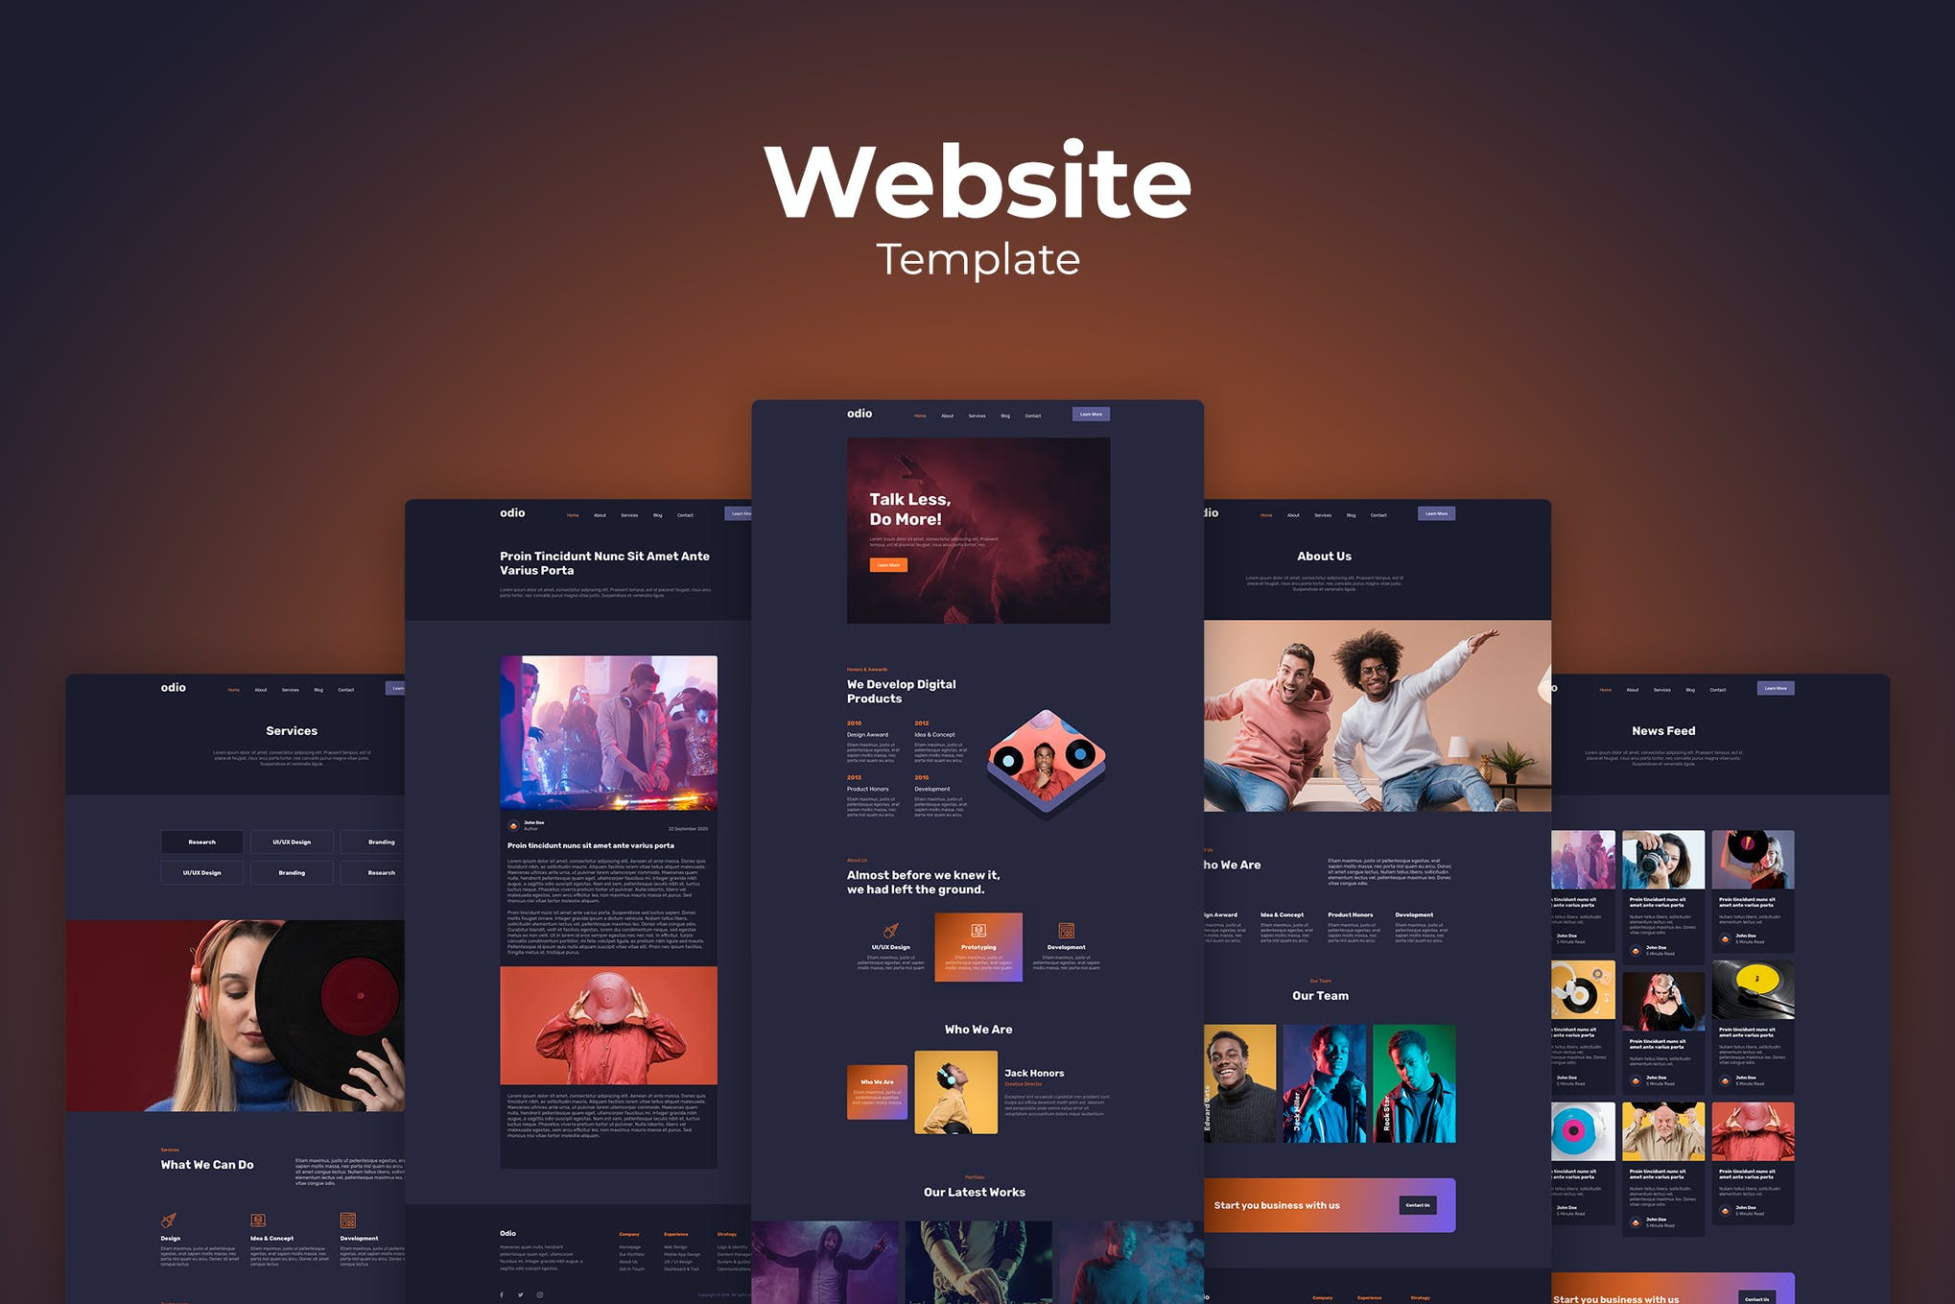
My Work
Work Experience
Education
About Me
Cover
WORK EXPERIENCE
NTI Training Final Project (Team Leadership)
College Final Project
Personal Web Design Projects

Slide 5
My Work
Work Experience
Education
About Me
Cover
MY WORK
https://drive.google.com/file/d/1Aa6k604jBT4OxhYh4LBzCNtfXTNZr4ur/view?usp=drivesdk
https://drive.google.com/file/d/1Aa6k604jBT4OxhYh4LBzCNtfXTNZr4ur/view?usp=drivesdk

Slide 6
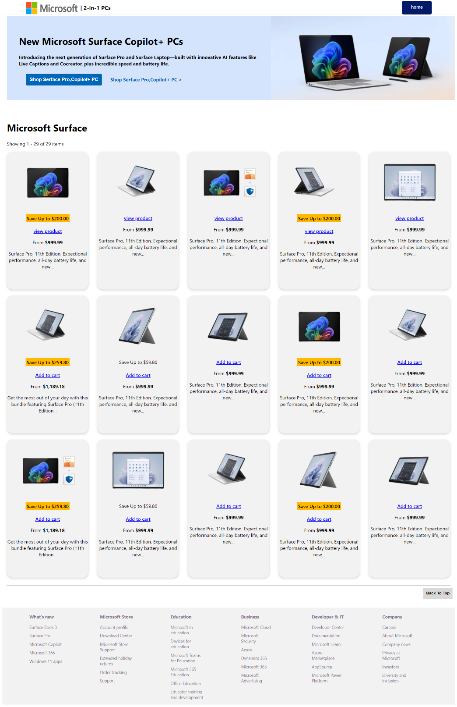
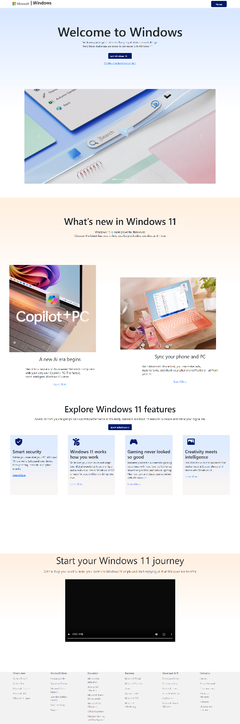
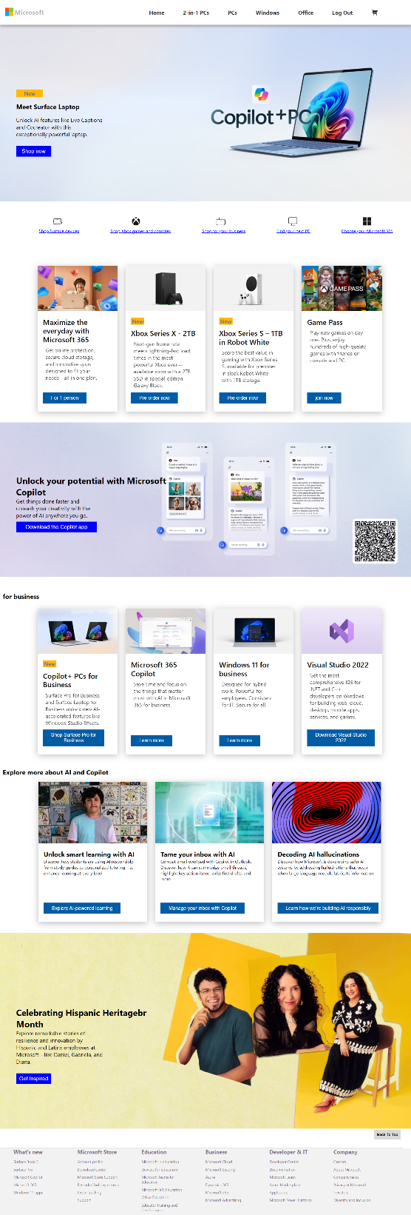
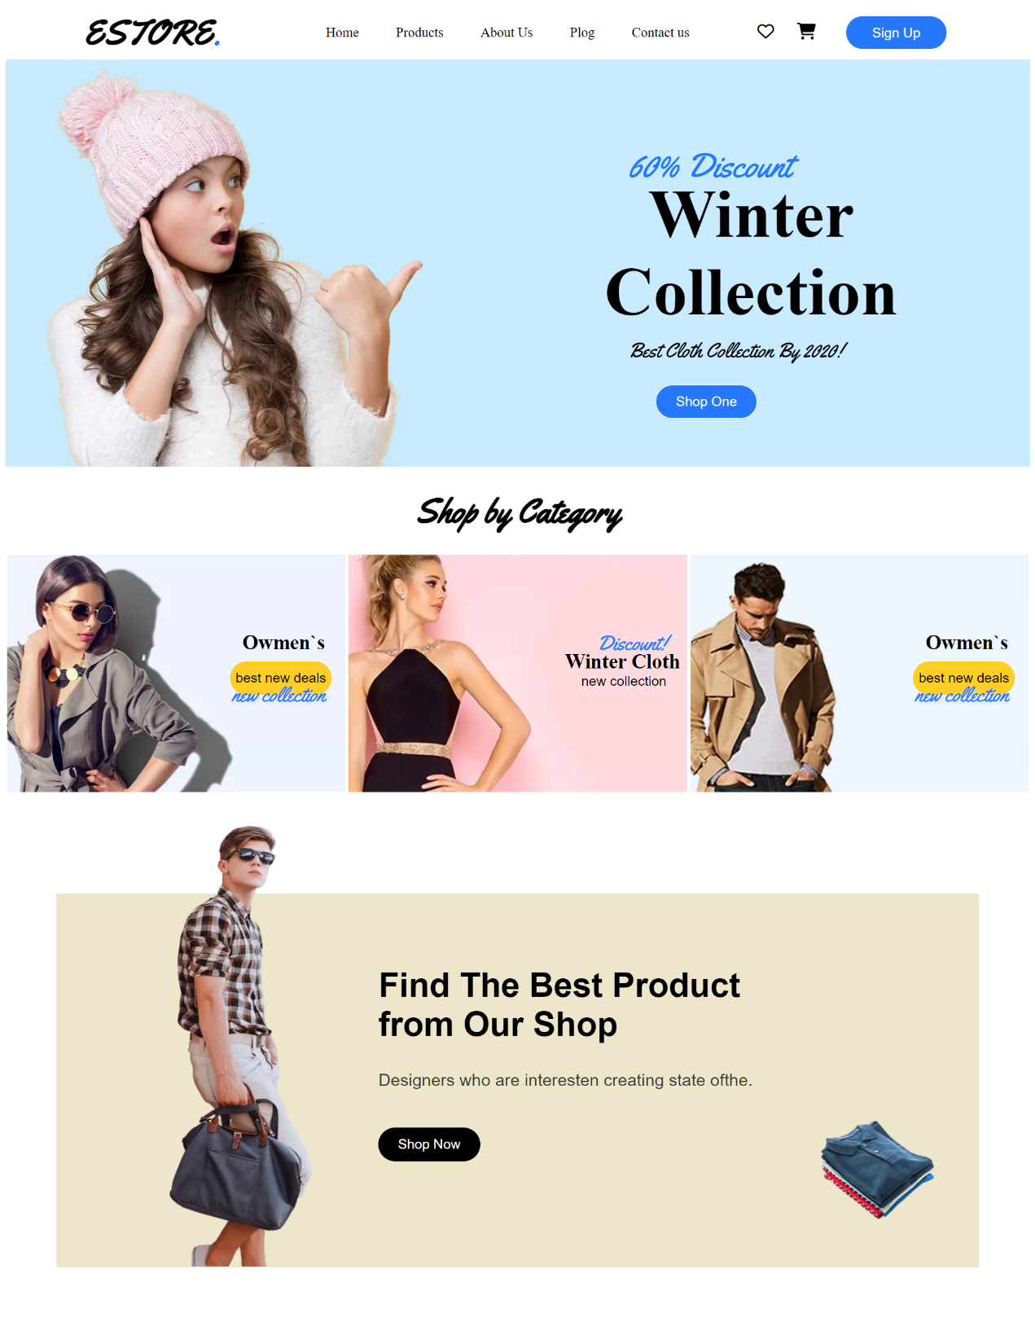
My Work
Work Experience
Education
About Me
Cover

Slide 7
My Work
Work Experience
Education
About Me
Cover
THANK YOU
That's my portfolio so far.

